Slide 1
Hoshin Action Plan Workshop

Slide 2
Purpose & Learning Objectives
Purpose:
To become familiar with the mechanics of creating an effective Hoshin Action Plan. This virtual training will assure Members a more efficient, meaningful, and productive Hoshin experience when in the IMPLEMENT phase of their respective Hoshin AIPs.
Learning Objectives:
Participants will learn the various steps in creating their Hoshin Action Plans, including the following:
  Definition of an Action Plan
  How Action Plans tie back to the 2nd Level Hoshin Matrices
  Action Plan Thinking Process
  Anatomy of Major-Minor Relationships
  Company’s Recommended Action Plan Format
  Action Plan Checklist

Slide 3

7 Phases of the Hoshin Process
Based on the Deming Cycle - PDCA
Develop LRP
Plan
Develop Long-Term Stretch Objectives
Catchball
Do
Check
Act
Develop AIPs, Targets Top Level
We are here!
Develop AIPs, Targets, Resources - 2nd Level
Targeted
CI Efforts
8D
Counter-
measures
Implement AIPs
Monthly PDCA Review
Annual Review
QUESTION: Where could be the failure point in your organization?
Notes:
DO: BREIFLY walk the group through this chart noting that you will be taking them through each step in the process in great detail. Key points to stress:
Strategic Deployment is a PROCESS.
The SD process is mirrored after the PDCA cycle.
You must do ALL of the steps to be successful.
Most companies fail by not implementing steps 5 & 6.
Just because you “Planned” does not mean you did SD.
Note the considerable amount of steps in “Plan” vs. other steps. This is typically a Japanese philosophy where they will spend more time in Planning and a small amount of time in the execution (DO) stage. This is sometimes the opposite thinking of traditional Western management.
SAY: “This cycle is based on the Deming Cycle, or the Plan-Do-Check-Act cycle. When leading with Strategic Deployment your business and its processes will continuously be at different points of implementing this cycle. Notice that it is a cycle (and there are cycles within the cycle) because continuous improvement never ends.

Slide 4
Hoshin Action Plans Defined
Definition
Characteristics
Pitfalls
Action Plans are the “recipe” to create a sustainable business process
A detailed list of actions and tasks necessary for the successful implementation of a Second Level AIP
Includes the necessary steps to create the 2nd Level AIP
The process is the end result of a completed action plan
One Action Plan for each 2nd Level AIP
Responsibility and due dates are listed for each task
Needs to be reviewed frequently by team leader and team members
Is a dynamic document, updated frequently for new activity, etc.
Needs to be monitored and audited by management team
Contains a MAJOR and MINOR Action Item relationship
Action items must be prioritized and hit the “Point of Impact”
Teams plan the work but do not work the plan
Scope Creep - Action Plan items do not tie to the AIP
Teams do not meet frequently enough to keep the Action Plan a living, dynamic document
Poor resource allocation and overload, which pushes out due dates
The Action Plan is too detailed, making it difficult to manage the process
Treated as a form-filling process
Action Plans Must Be Linked to the Point of Impact

Slide 5
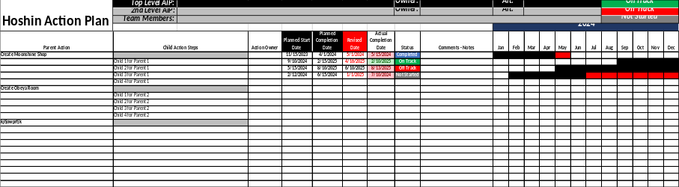
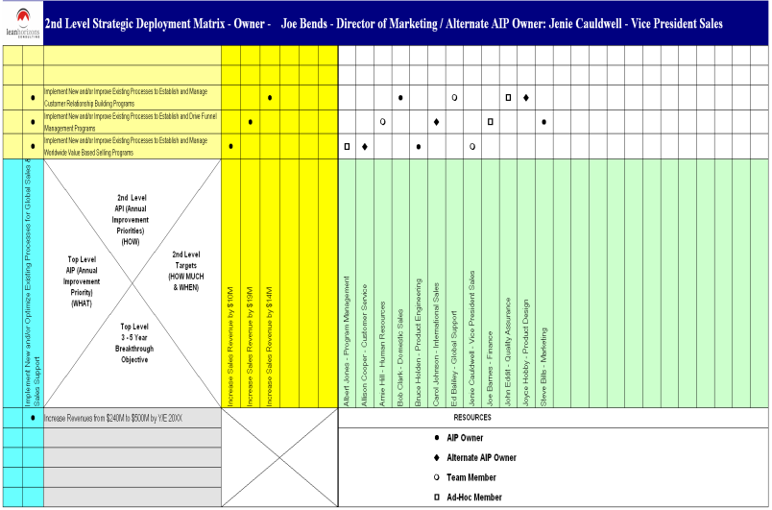
Action Plans Relationship with the Second Level Matrix
Action Plans
One Action Plan for Each 2nd Level AIP
AIP 1
Second Level Matrix
3
AIPs
AIP 2
AIP 3
An Independent Action Plan for each 2nd Level AIP

Slide 6
Action Plans – Thinking Process
Determine Action Plan Major Actions
Determine Initial Major Actions
Prioritize Major Actions
Determine Completion Dates
Assign Major Action Owner
Develop Minor Actions Under Each Major Action
Determine Initial Minor Actions
Prioritize Minor Actions
Assign Owners of Each Minor Action
Establish Completion Dates
Verify Resource Allocation Load (Adjust if Req'd)
AIP Team Review
Review Existing Action Plans
Confirm Due Dates
Update Due Dates and/or Assignments
Add New Tasks as Required
Verify Resource Allocation Load (Adjust if Req'd)
1
2
3

Slide 7
Action Steps Complete the Cause and Effect Chain
Breakthrough Objective:
Improve Employee Engagement Score by 50% by 12/31/26
Effect = Results!
Top Level Annual Improvement Priority
Implement Talent Management & Development Process
Effect = Cause
Second Level AIP
Implement Career Development Process
Effect = Cause
Major Action 1:
Develop Career Profile Inventory for Targeted
Positions
Major Action 2:
Develop High Potential Management Process
Actions = Cause
Major Action 3:
Develop OJT Training and Immersion Program
= POINT OF IMPACT
Notes:
SAY: “The cumulative effect of the action steps from the Action Plans tie in to achieving higher level AIP’s (in this case the Second level) which in turn tie into meeting the next higher level AIP’s (1st level) which tie into meeting the Breakthrough Objectives for the business.
There should be a cause and effect relationship between these levels.”
Action Plans need to be populated to get the job done, level of detail needs to be appropriate to achieve AIP.

Slide 8
Anatomy of a Major - Minor Action Item Relationship
Minor Actions:
Draft Initial Inventory for Key Positions:
  Operations VP
  Sales VP
  Marketing VP
  CFO
  HR VP
  Engineering VP
Review Draft with Each Functional Leader
Develop Career Development Execution Process
Socialize and Gain Approval from CEO and C-Suite Staff
Major Action 1:
Develop Career Profile Inventory
for Targeted Positions
POINT OF IMPACT
Input Into Hoshin Action Plan
(See Next Page)
Notes:
SAY: “The cumulative effect of the action steps from the Action Plans tie in to achieving higher level AIP’s (in this case the Second level) which in turn tie into meeting the next higher level AIP’s (1st level) which tie into meeting the Breakthrough Objectives for the business.
There should be a cause and effect relationship between these levels.”
Action Plans need to be populated to get the job done, level of detail needs to be appropriate to achieve AIP.

Slide 9
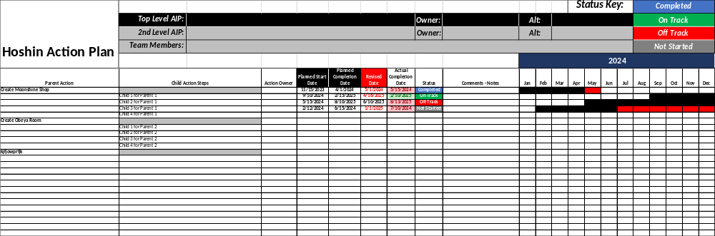
Hoshin Action Plan
Action Plans are the “Point of Impact”
Notes:
SAY: “This will essentially be the ‘to do’ list to accomplish the AIP. Note that we want to see Owners, Start/End times.”

Slide 10

Action Plan Checklist
Your Action Plan Should…
Tie to a 2nd Level AIP
Contain Major-Minor Action Step Relationships
Major Actions have a Cause & Effect relationship with the AIP
Be void of scope creep
Contain Responsibilities, Due Dates
Be appropriately prioritized
Be stress-tested for resource load
Involve the right people for the right job

Slide 11

Final Thought:
You have planned the work, now you must work the plan! Failure to do so is the most common failure point in the Hoshin process.
Dynamic Action Plans are where you will reach the “Point of Impact”

